Slide 1






DevOps
Continuous Integration

Slide 2

What's in It for Me
What is Continuous Integration
Understanding Jenkins as CI Tool
Learn how to configure, manage, and run CI
Pipeline in Cloud
Why we need Continuous Integration

Slide 3
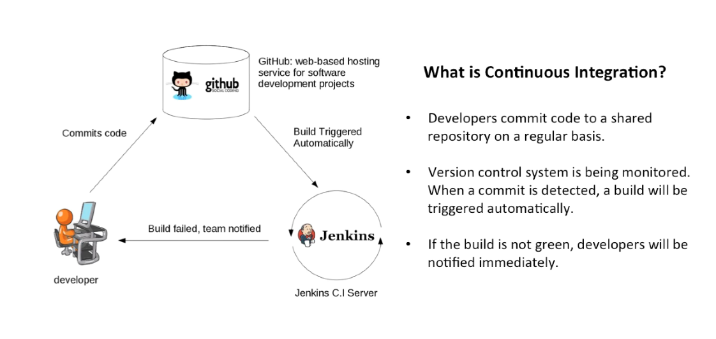

Slide 4

Continuous Integration
Shares code and unit tests by merging changes into a shared version control repository
Triggers an automated build system to get the latest code from the shared repository
² ³
Integrates the changes made by software
4 developers with the
team’s code base
Process of automating the
build and testing of code
1
Eliminates long waiting periods to minimize merge conflicts, hard to fix bugs, diverging code strategies, and duplicated efforts
Popular CI tools in the market are Jenkins, TeamCity, Travis CI, Bamboo, and CodeShip
7
5
6
Requires development team’s code to be merged with a shared version control branch continuously to avoid problems

Slide 5
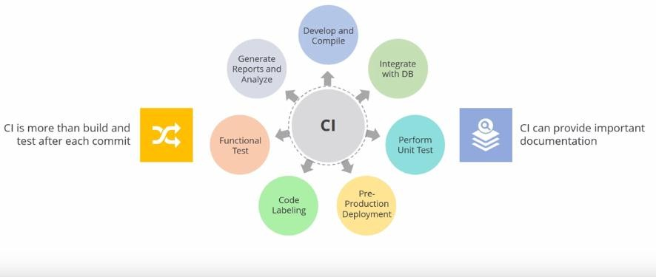
Continuous Integration (Contd.)

Slide 6
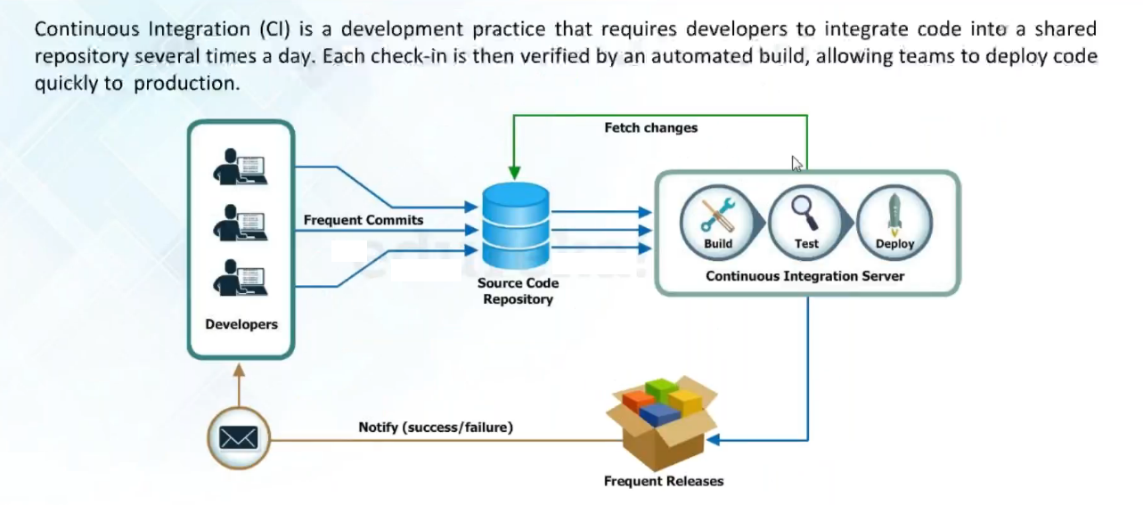
Continuous Integration (Contd.)

Slide 7
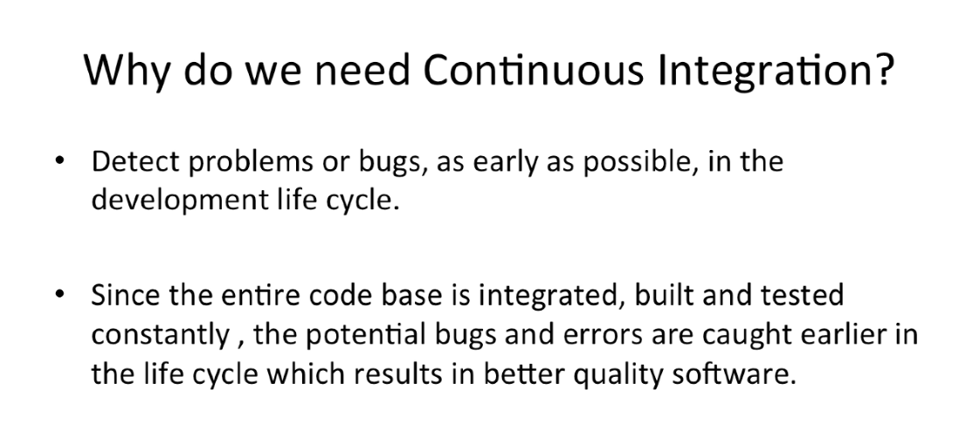

Slide 8
CI - Defined
. “Continuous Integration is a software development practice
where members of a team integrate their work frequently,
usually each person integrates at least daily - leading to
multiple integrations per day. Each integration is verified by
an automated build (including test) to detect integration
errors as quickly as possible” – Martin Fowler

Slide 9



Jenkins
Using Jenkins as Continuous Integration Tool

Slide 10
Continuous Integration is the most important part of DevOps that is used to integrate various DevOps stages. Jenkins is the most famous Continuous Integration tool,
What is Jenkins?
Jenkins is an open source automation tool written in Java with plugins built for Continuous Integration purpose.
Jenkins is used to build and test your software projects continuously making it easier for developers to integrate changes to the project, and making it easier for users to obtain a fresh build.
It also allows you to continuously deliver your software by integrating with a large number of testing and deployment technologies.
With Jenkins, organizations can accelerate the software development process through automation. Jenkins integrates development life-cycle processes of all kinds, including build, document, test, package, stage, deploy, static analysis and much more.
Jenkins achieves Continuous Integration with the help of plugins. Plugins allows the integration of Various DevOps stages. If you want to integrate a particular tool, you need to install the plugins for that tool. For example: Git, Maven 2 project, Amazon EC2, HTML publisher etc.

Slide 11
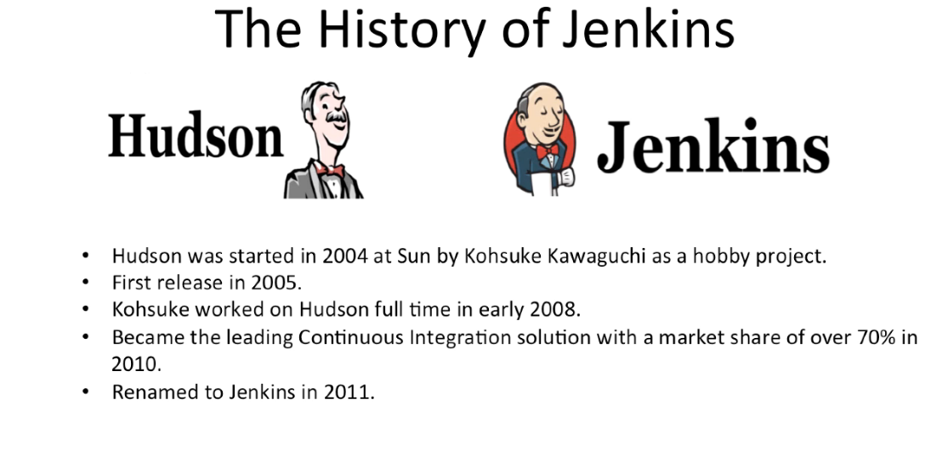

Slide 12
Jenkins
Open source automation server
Software development
Cross-platform tool
Java based
Jenkins is written in Java. It was forked from Hudson when Oracle bought Sun Microsystems
It provides hundreds of plugins to support build creation, deployment, and automation of any software project
It helps automate non-human part of software development process with CI and continuous deployment (CD)
It is a cross- platform tool, and it offers configuration both through GUI interface and console commands

Slide 13
Jenkins
CI server
Distribution
Cross-platform
It can be used as a CI server or as a continuous delivery hub for a project
It can easily distribute work across different machines and help trigger builds, tests, and deployments to multiple machines and platforms faster
It works on iOS, .Net, Android Development, Ruby, and Java

Slide 14
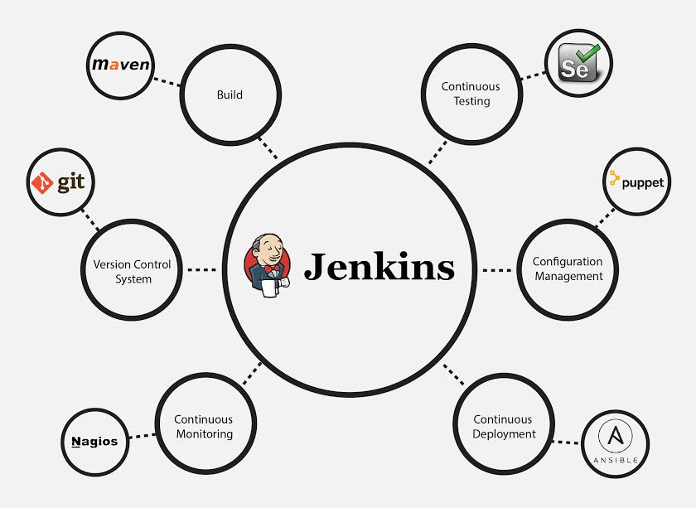
The image below depicts that Jenkins is integrating various DevOps stages:

Slide 15
Advantages of Jenkins include:
It is an open source tool with great community support.
It is easy to install.
It has 1000+ plugins to ease your work. If a plugin does not exist, you can code it and share with the community.
It is free of cost.
It is built with Java and hence, it is portable to all the major platforms.
Jenkins Key Metrics:
Following are some facts about Jenkins that makes it better than other Continuous Integration tools:
Adoption: Jenkins is widespread, with more than 147,000 active installations and over 1 million users around the world.
Plugins: Jenkins is interconnected with well over 1,000 plugins that allow it to integrate with most of the development, testing and deployment tools.

Slide 16
Without - Continuous Integration With Jenkins
Let us imagine a scenario where the complete source code of the application was built and then deployed on test server for testing. It sounds like a perfect way to develop a software, but, this process has many flaws. I will try to explain them one by one:
Developers have to wait till the complete software is developed for the test results.
There is a high possibility that the test results might show multiple bugs. It was tough for developers to locate those bugs because they have to check the entire source code of the application.
It slows the software delivery process.
Continuous feedback pertaining to things like coding or architectural issues, build failures, test status and file release uploads was missing due to which the quality of software can go down.
The whole process was manual which increases the risk of frequent failure.
It is evident from the above stated problems that not only the software delivery process became slow but the quality of software also went down. This leads to customer dissatisfaction. So to overcome such a chaos there was a dire need for a system to exist where developers can continuously trigger a build and test for every change made in the source code. This is what CI is all about. Jenkins is the most mature CI tool available so let us see how Continuous Integration with Jenkins overcame the above shortcomings.

Slide 17
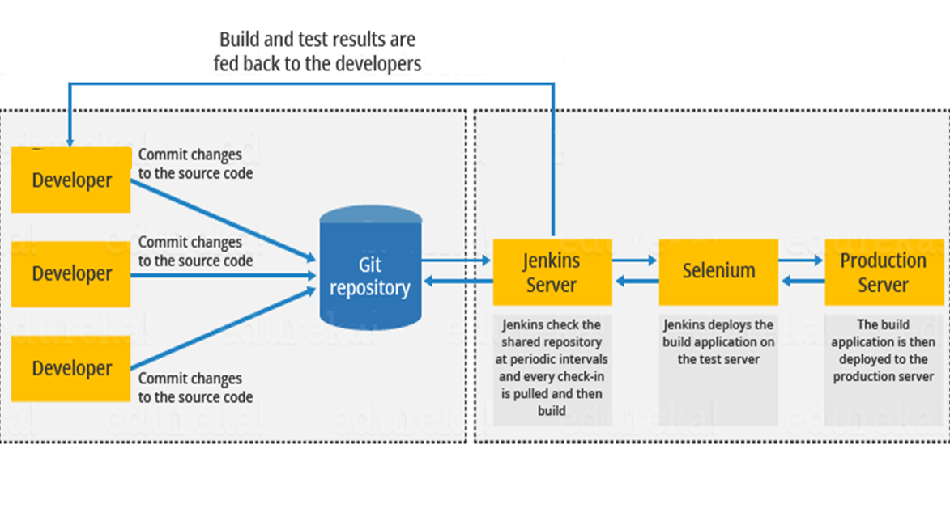

Slide 18
The above diagram is depicting the following functions:
First, a developer commits the code to the source code repository. Meanwhile, the Jenkins server checks the repository at regular intervals for changes.
Soon after a commit occurs, the Jenkins server detects the changes that have occurred in the source code repository. Jenkins will pull those changes and will start preparing a new build.
If the build fails, then the concerned team will be notified.
If built is successful, then Jenkins deploys the built in the test server.
After testing, Jenkins generates a feedback and then notifies the developers about the build and test results.
It will continue to check the source code repository for changes made in the source code and the whole process keeps on repeating.

Slide 19
Before Jenkins | After Jenkins
The entire source code was built and then tested. Locating and fixing bugs in the event of build and test failure was difficult and time consuming, which in turn slows the software delivery process. | Every commit made in the source code is built and tested. So, instead of checking the entire source code developers only need to focus on a particular commit. This leads to frequent new software releases.
Developers have to wait for test results | Developers know the test result of every commit made in the source code on the run.
The whole process is manual | You only need to commit changes to the source code and Jenkins will automate the rest of the process for you.

Slide 20
Continuous Integration Using Jenkins
Builds can be triggered from a commit in version control system or scheduling a cron job or by other
builds in the queue
Support version control systems like CVS, Subversion, Git, Perforce, Clearcase
Can be integrated with bug tracking databases Jira, Bugzilla, Sonar Quality Gate
Integrates with testing tools like Nunit, Junit, TestLink, Celenium Capability Axis, qTest, QMetry for Jira, Sonar
Integrates with build tools like NAnt, EasyAnt, Ansible, Ant, Maven, Gradle, Visual Studio Code Metrics,
SaltStack, Python, Ruby, Shell and Windows commands
Integrates with config tools like Chef, Puppet, Ansible, Vagrant, IBM Rational, SaltStack
Has plugins for Puppet Enterprise Pipeline, Ansible, OctopusDeploy, Docker Pipeline, Google Deployment Manager, Amazon Web Services, VMWare, Azure, Microsoft .Net, OpenStack

Slide 21
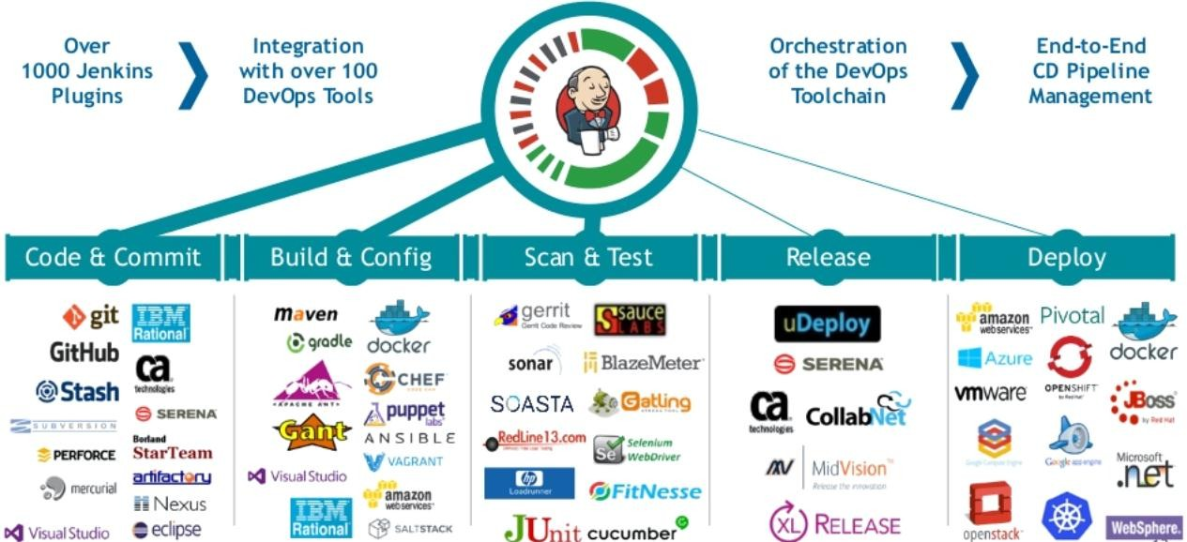
Continuous Integration Using Jenkins (Contd.)

Slide 22
Jenkins Architecture
Jenkins is a set of Java classes that model the concepts of a build system in a
straight-forward fashion
There are classes like Project, Build, that represents what the name says
There are interfaces and classes that model code that performs a part of a build, such as SCM for accessing source code control system, Ant for performing an Ant- based build, Mailer for sending out e-mail notifications
Jenkins classes are bound to URLs by using Stapler. Stapler is a HTTP request handling server.

Slide 23
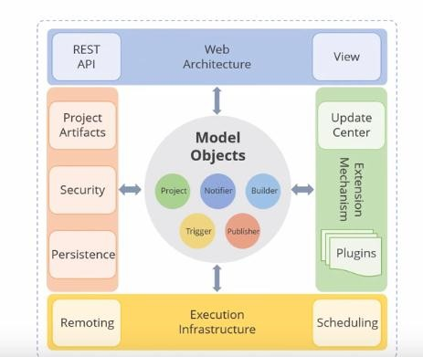
Jenkins Architecture in Detail
Views
Jenkins' model objects have multiple "views" that are used to render HTML pages about each object.
Jenkins uses Jelly as the view technology.
Persistence
Jenkins uses the file system to store its data. Directories are created inside $JENKINS_HOME in a way that models the object model structure.
Plugins
Jenkins' object model is extensible and it supports the notion of "plugins," which can plug into those extensibility points and extend the capabilities of Jenkins.

Slide 24
Step 1. Launch an instance (Amazon Linux) , Login to the instance, install and setup java environment
sudo yum install -y git java-1.8.0-openjdk-devel aws-cli
sudo alternatives --config java
In this command change version of java to the latest version.
Step 2. Install Apache Maven
sudo wget http://repos.fedorapeople.org/repos/dchen/apache-maven/epel-apache-maven.repo -O /etc/yum.repos.d/epel-apache-maven.repo
sudo sed -i s/\$releasever/6/g /etc/yum.repos.d/epel-apache-maven.repo
yum install -y apache-maven
mvn --version
Step 4. Install Jenkins
wget -O /etc/yum.repos.d/jenkins.repo http://pkg.jenkins-ci.org/redhat-stable/jenkins.repo
rpm --import http://pkg.jenkins-ci.org/redhat-stable/jenkins-ci.org.key
sudo yum install jenkins
sudo service jenkins start
sudo chkconfig --add jenkins
That’s it! Now you can go to URL http://<instance ip>:8080

Slide 25
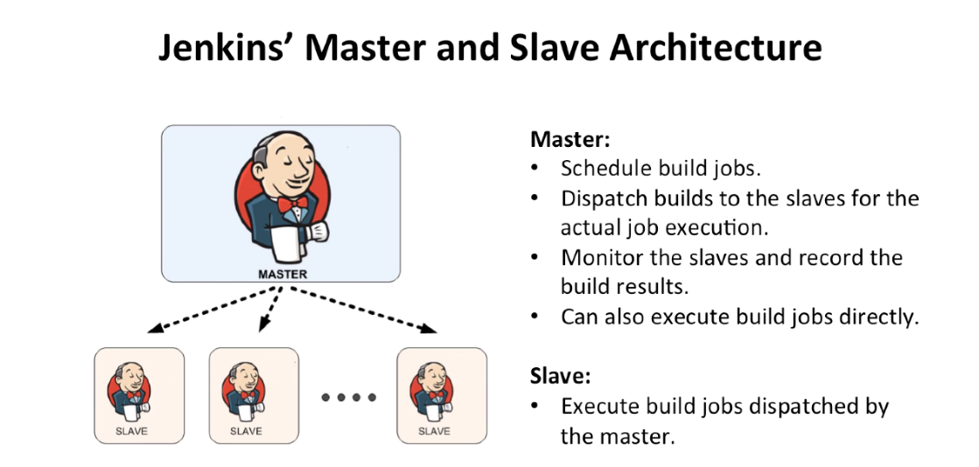

Slide 26
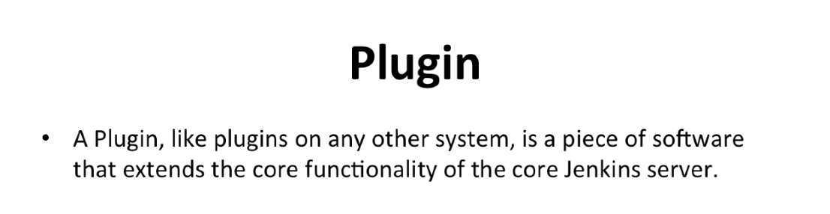

Slide 27
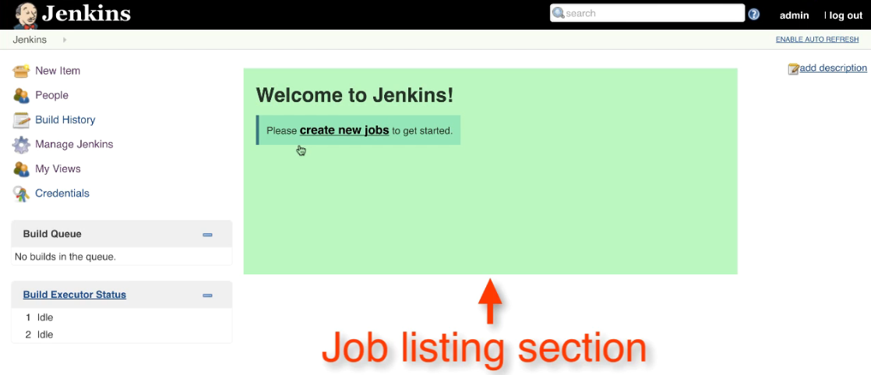

Slide 28
Key Takeaways
Continuous Integration automates the build and testing of code for every
commit to version control.
Tools used for Continuous Integration are Jenkins, TeamCity, Travis CI, Bamboo, and CodeShip.
Jenkins is a cross-platform tool and offers configuration both through GUI interface and console commands.
TeamCity is a Java-based build management and continuous integration
server.

Slide 29
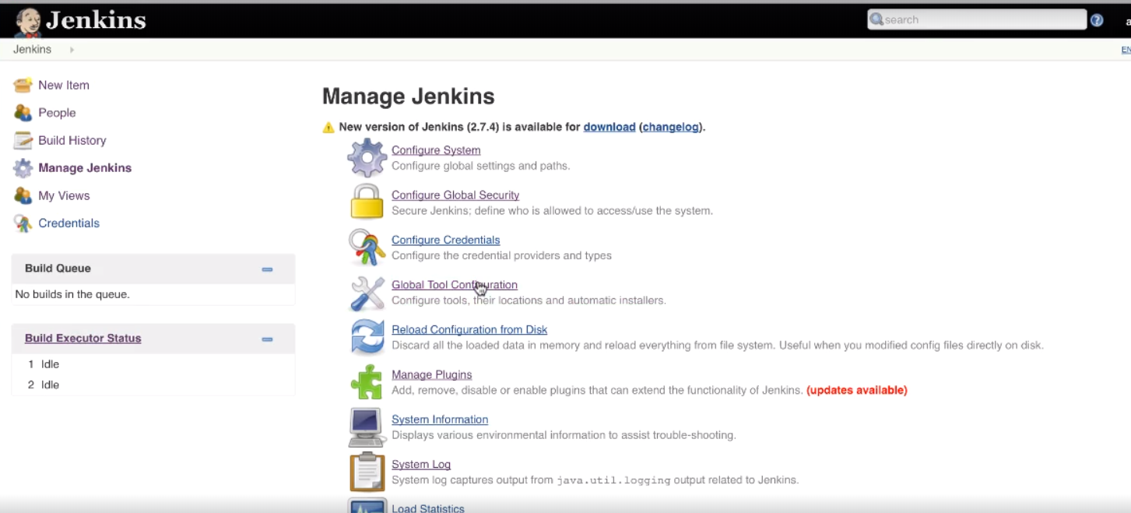
Configure Jenkins to work Maven, Java and GIT
Go to Manage Jenkins then select Global Tool Configuration
As you see we need to setup couple of things like JDK, GIT, Maven etc. So Jenkins to know where to locate those tools while build process.

Slide 30
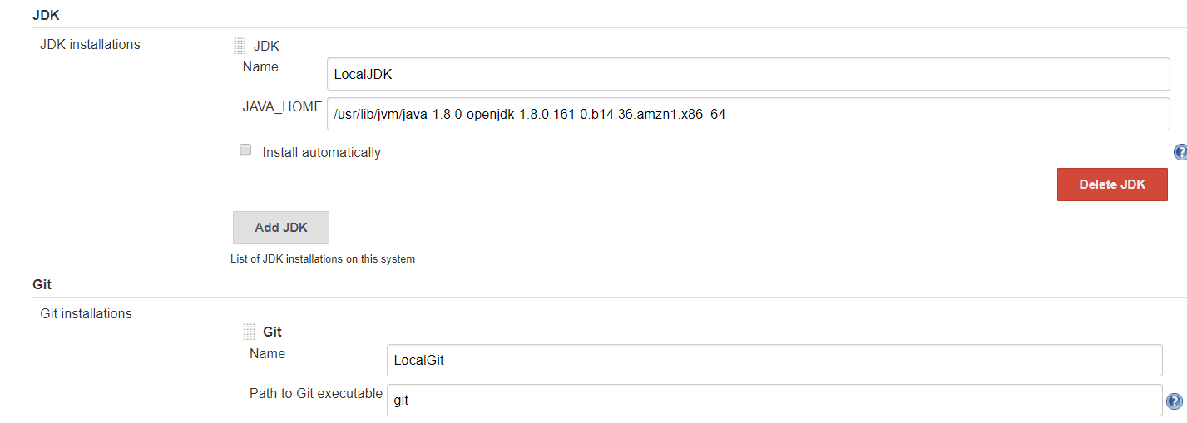
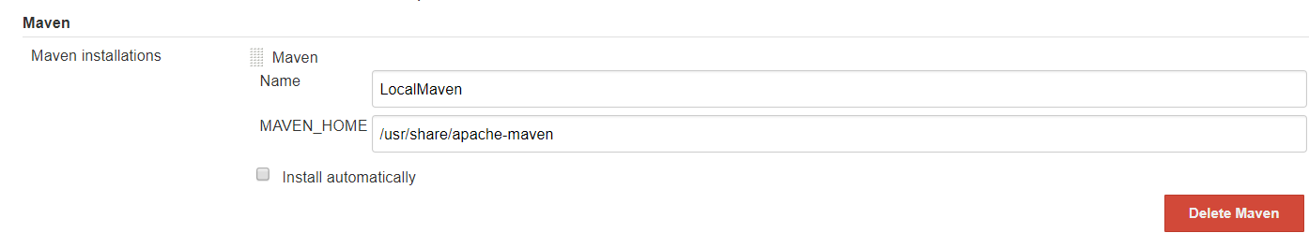

Slide 31
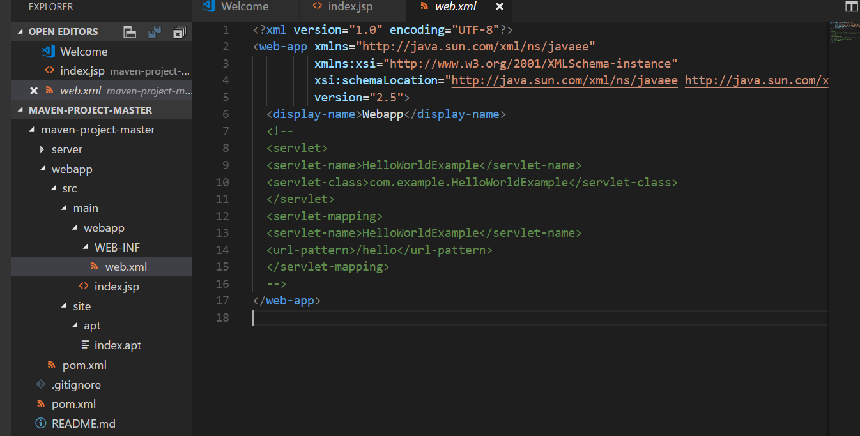
First Maven Based Project:
Github repo UTR https://github.com/prakashk0301/maven-project.git
Web.xml: it will tell you how to deploy your application
Index.jsp: Html page information ,which we can see after successful deployment.

Slide 32
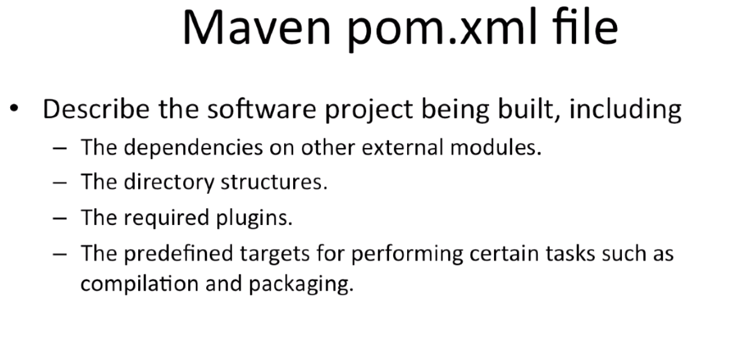

Slide 33
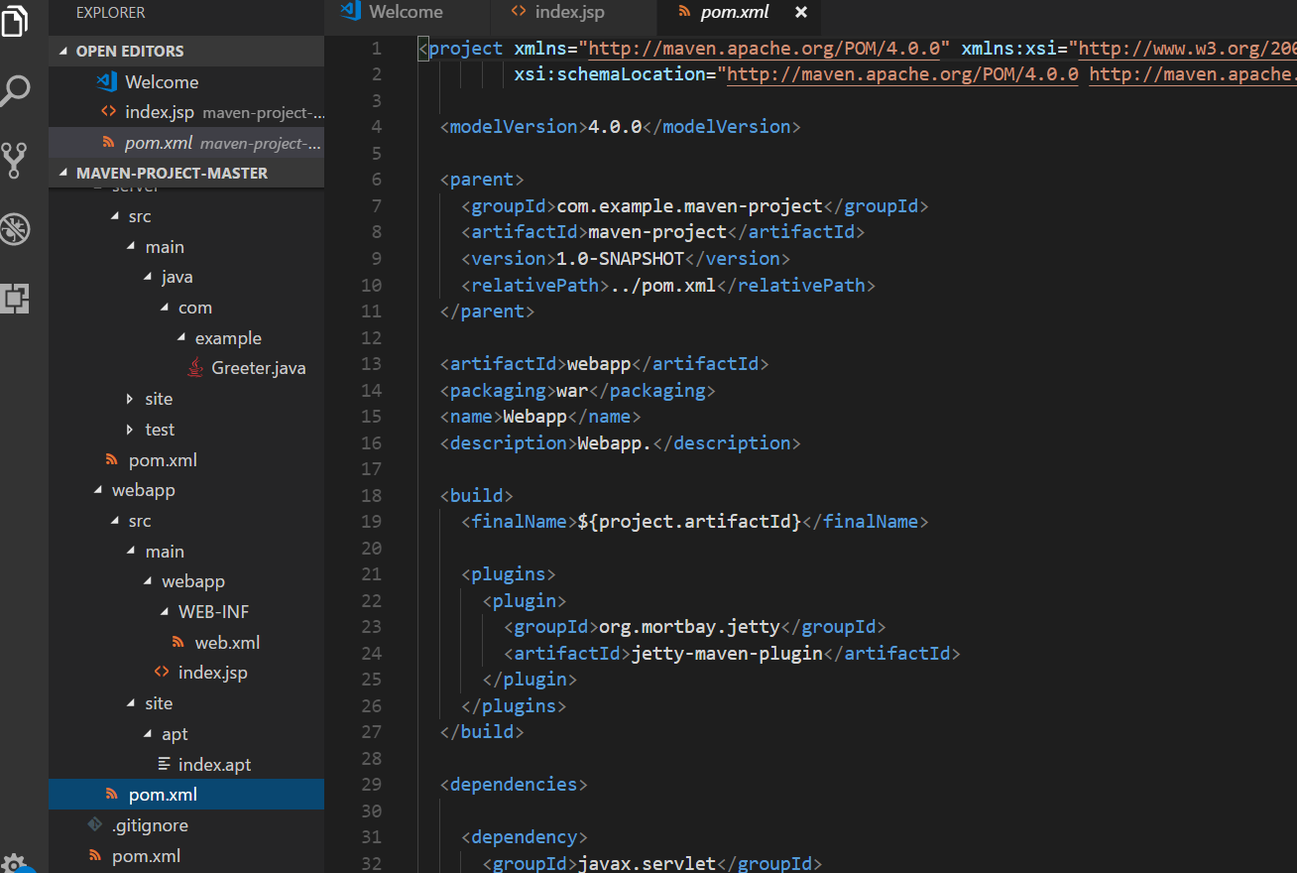
In our project we have total 3 pom.xml file

Slide 34
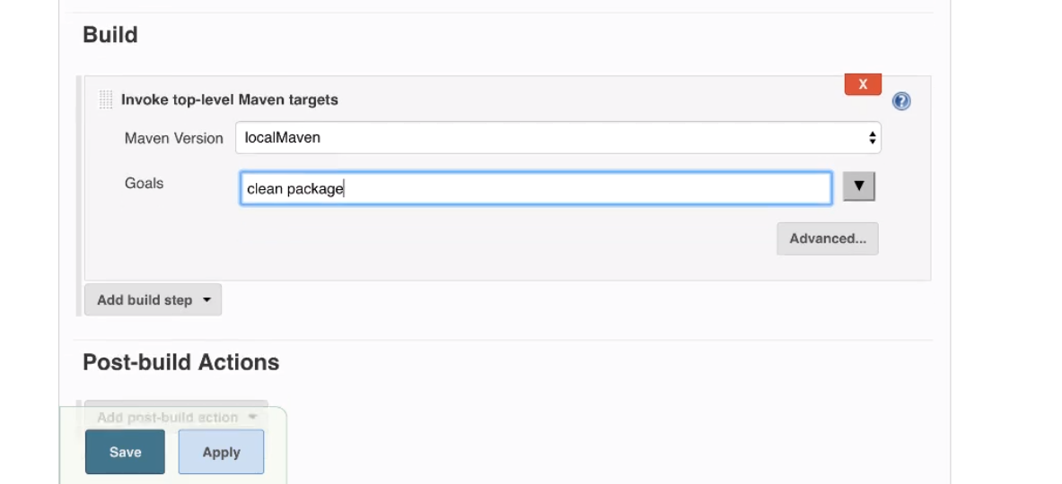

Slide 35
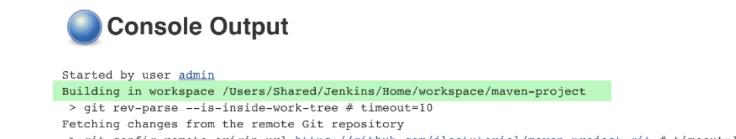
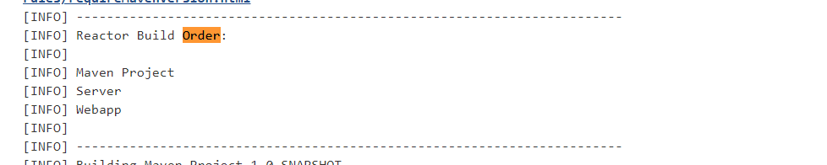
Jenkins has build our project in a workspace under a shared directory on the local box
Jenkins figured out the right order to build the job, First one is the root directory of our project

Slide 36
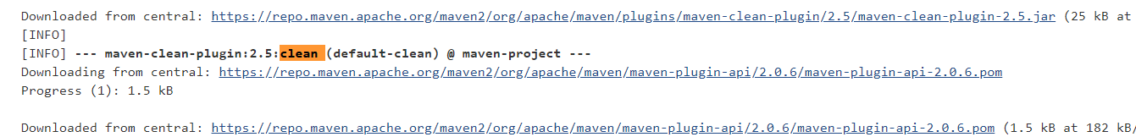
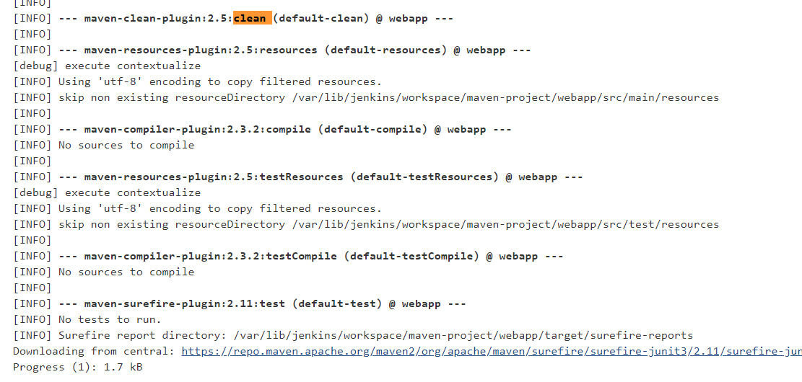
Cleaning the environment before building the job, Basically it is removing any artifact before building
Server module: Jenkins is executing the sequence of build command such as compile, test for packaging

Slide 37
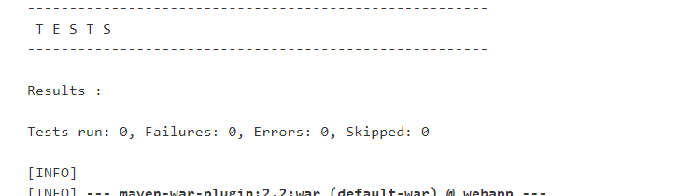
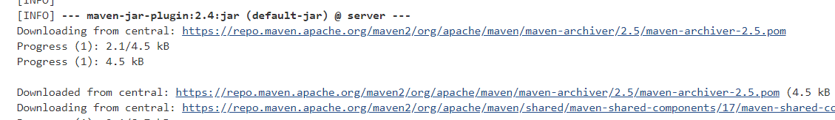
After server module it prints out the Unit test report
Lastly it package the Server module and producing the jar file under the server directory

Slide 38
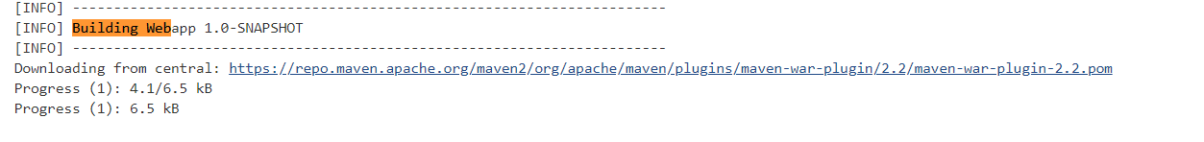
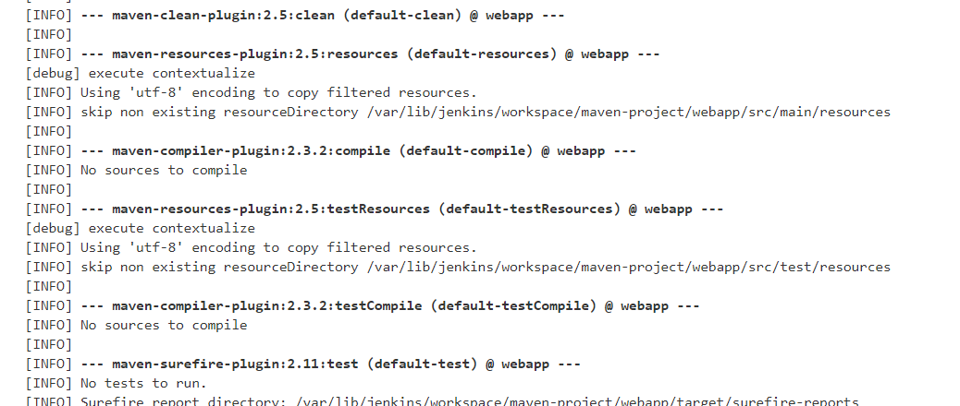
Building the webapp module which is pretty similar to the server module

Slide 39
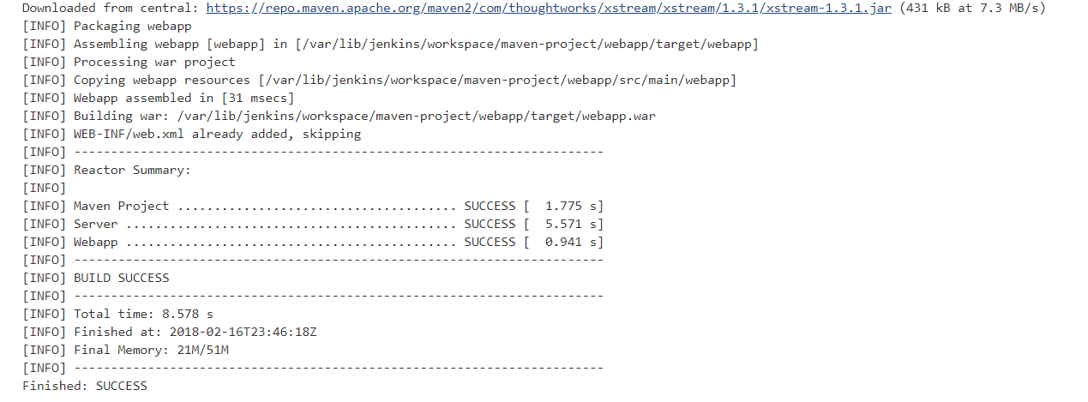
In the end it packages the webapp module and produces the webapp war file which can be further deploy to
servlet container like tomcat, apache

Slide 40
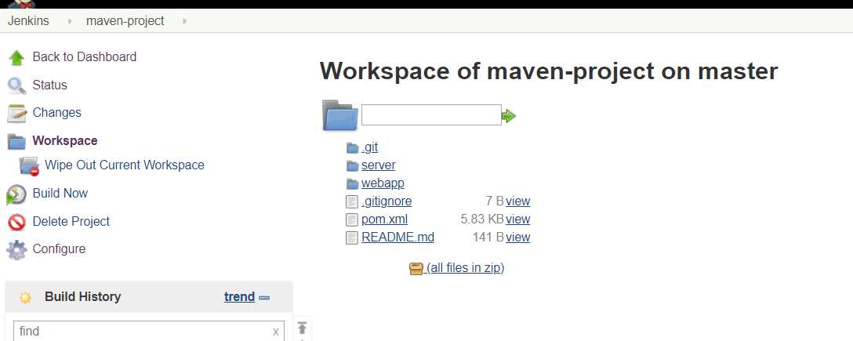
In workspace: It displays the directory structure of this workspace which Jenkins uses to
built the project

